Slide 1



PERSONAL AI AGENT
Personal AI Agent
A resume-aware practice platform that captures live interview conversation and helps candidates respond with confidence.
Flask backend
Live transcript
Desktop app
Created & built by Manoj
Python · Flask · OpenAI · pywebview
01

Slide 2


Why this project exists
Interview practice is often generic — this tool personalizes it using the candidate's own resume.
Resume-Aware
Live Transcript
Grounded Answers
Upload a PDF, DOCX, or TXT resume and the app extracts skills, education, projects, and experience automatically.
Captures interviewer and candidate speech into a running, timestamped transcript during a mock session.
Generates candidate-style answers using only resume facts — no invented experience, via OpenAI or a smart fallback.
02

Slide 3
How the application flows
From resume upload to a full interview transcript, in six steps.
1
Open App
2
Upload Resume
3
Start Interview
Candidate opens the local app at 127.0.0.1
PDF / DOCX / TXT parsed into a structured profile
Session created; candidate profile loaded
4
Capture Speech
5
Generate Answer
6
Review Transcript
Transcript segments logged with speaker + timestamp
AI drafts a grounded response from resume context
Full session available to replay or export
03

Slide 4
Seven-phase roadmap
Two phases shipped today; five phases ahead on the plan.
Phase 1.5
Phase 2
Phase 5
Phase 7
Resume Upload
Question Detection
Dashboard & Analytics
Deployment
Complete
Planned
Planned
Planned
Phase 1
Phase 3
Phase 6
Transcript Display
Answer Generation
UI Polish
Complete
Planned
Planned
04

Slide 5



Under the hood: tech stack
A lightweight Python stack, packaged for both web and desktop.
Flask
OpenAI API
pdfplumber / python-docx
Python backend & routing
gpt-3.5-turbo response generation
Resume parsing (PDF, DOCX, TXT)
pywebview
PyInstaller
python-dotenv
Native desktop window wrapper
Bundles app into a Windows .exe
Environment & secret management
05

Slide 6

Resume parsing in action
A sample resume converted into a structured candidate profile.
sample_resume.txt
Parsed candidate profile
Manoj Sharma
manoj@example.com | +91-9999-999999
Full-Stack Developer, 5 yrs — Python, data science, BI.
B.Tech IT — Lovely Professional University (2019-2023)
Senior Developer — Tech Solutions Inc. (2022-Present)
Junior Developer — Data Analytics Corp. (2021-2022)
Name
Manoj Sharma
Skills found
18+ (Python, SQL, Flask, TensorFlow…)
Education
1 entry (B.Tech IT)
Experience
2 roles
Projects
3 (incl. Air Pollution Prediction)
Certifications
3 (Google, AWS, Coursera)
06

Slide 7
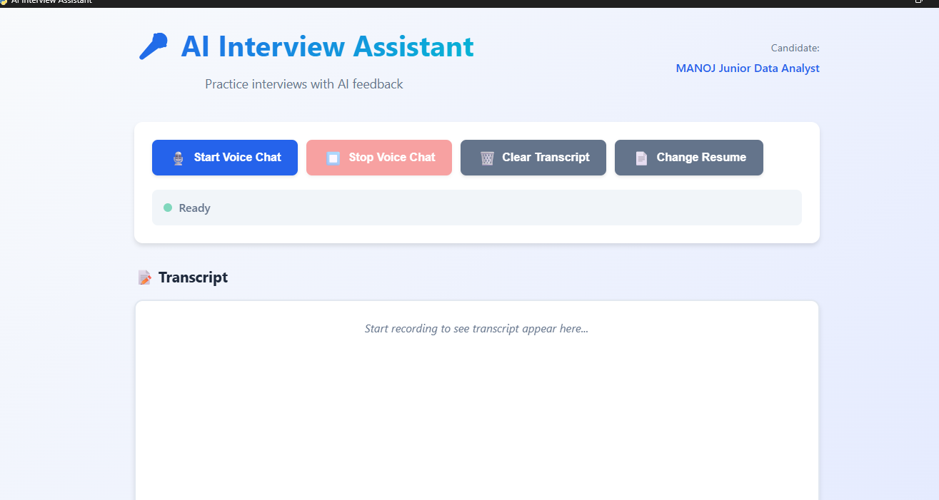
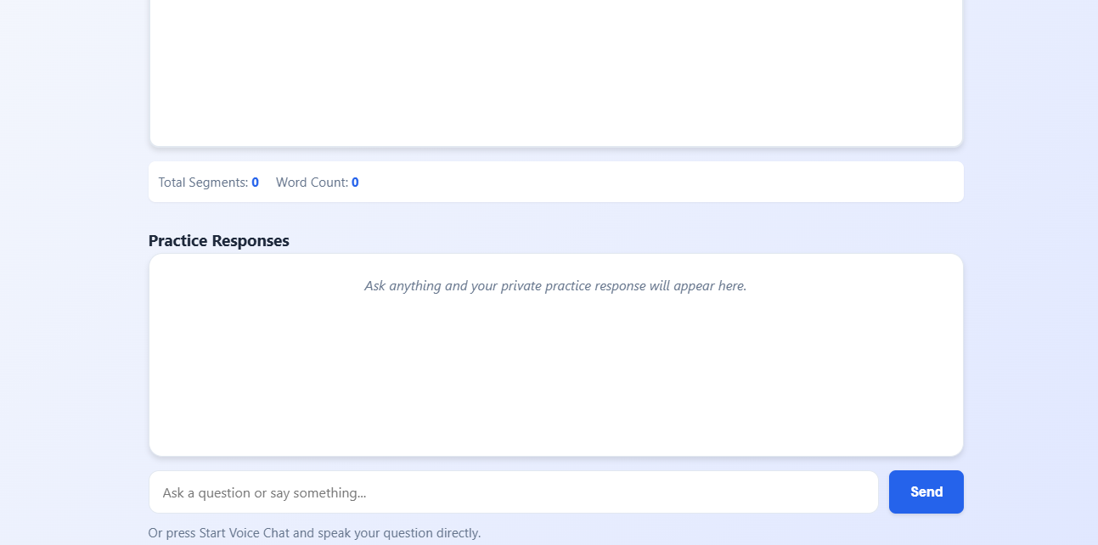
The app, live
The actual interview screen — voice controls, transcript, and private practice responses.
Practice-response panel with word-count tracking
Voice chat controls & live transcript
07

Slide 8
Core API endpoints
The Flask routes that power resume upload, chat, and transcript management.
Method | Route | Purpose
POST | /api/upload-resume | Upload & parse a resume file into a profile
GET | /api/get-profile | Retrieve the current candidate profile
POST | /api/start-session | Initialize a new interview session
POST | /api/add-transcript | Append a speaker segment to the transcript
GET | /api/get-transcript | Retrieve the full session transcript
POST | /api/clear-transcript | Reset the transcript for a session
POST | /api/chat | Generate a resume-grounded interview answer
GET | /health | Basic server health check
08

Slide 9
Two ways to run it
The same Flask app powers both a browser workflow and a packaged desktop app.
Run locally (app.py)
Package as desktop app
python -m venv venv
pip install -r requirements.txt
cp .env.example .env
python app.py
./run_app.ps1
pyinstaller --onefile --windowed \
--name "Personal AI Agent" \
desktop_app.py
Serves the Flask app on http://localhost:5000 — best for iterating on templates and API routes.
desktop_app.py starts Flask on a background thread and opens it in a native pywebview window — output .exe lands in dist/.
09

Slide 10

Configuration at a glance
Environment variables and Flask config classes keep secrets and behavior separate from code.
.env variables
Flask config classes
FLASK_ENV=development
SECRET_KEY=your-secret-key
OPENAI_API_KEY=sk-...
MODEL_TYPE=gpt-3.5-turbo
OLLAMA_BASE_URL=http://localhost:11434
MAX_UPLOAD_SIZE=16777216
Development
DEBUG=True — active local build
Production
DEBUG=False — deployment target
Testing
DEBUG=True, TESTING=True
Shared across all modes: 16MB max upload, allowed types pdf / docx / txt.
10

Slide 11


References & tools used
Built with the help of the following AI assistants and development tools.
ChatGPT
Claude
Perplexity
OpenAI API
VS Code
Conversational coding assistance & drafting
Reasoning, code review, and documentation
Research & up-to-date reference lookups
Model backend powering chat responses
Primary editor for writing & testing code
Tool names are used for attribution only; this project is independent and unaffiliated with these providers.
11

Slide 12

What's next
Two phases live.
Five to go.
Question detection
Auto-flag interviewer questions in the live transcript
Answer generation
Full AI-suggested responses using resume context
Analytics dashboard
Confidence scoring & topic breakdown with charts
Flask · OpenAI · pywebview · PyInstaller
12

